Slide 1
NAME : D SAI SNEHAN DEPT : CSE REG NO : 210420104038

Slide 2
PROJECT TITLE
TECH ZONE

Slide 3
OBJECTIVE
E -LEARNING PLATFORM.
EASY TO LEARN ADVANCE TECHNOLOGY.
HAVING TO DO WITH KNOWLEDGE AND MENTAL SKILLS.
COURSES ARE AVAILABLE IN THREE DIFFERENT LANGUAGES.

Slide 4
INTRODUCTION
E-Learning
E-learning is the latest in cutting edge strategies for knowledge dissemination. It’s commonly used by high schools, universities, and businesses as a way to increase flexibility and accessibility. These online courses can be accessed remotely by off-site employees and they can increase engagement by making use of multiple media formats. As a result, you’ll see higher levels of employee satisfaction and retention.

Slide 5

DOMAIN

Slide 6



TECH STACK

Slide 7
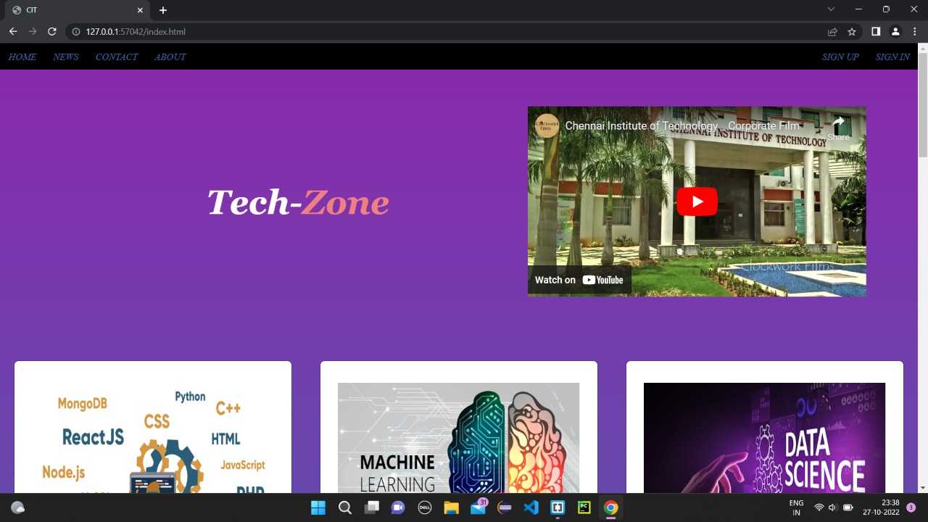

Slide 8
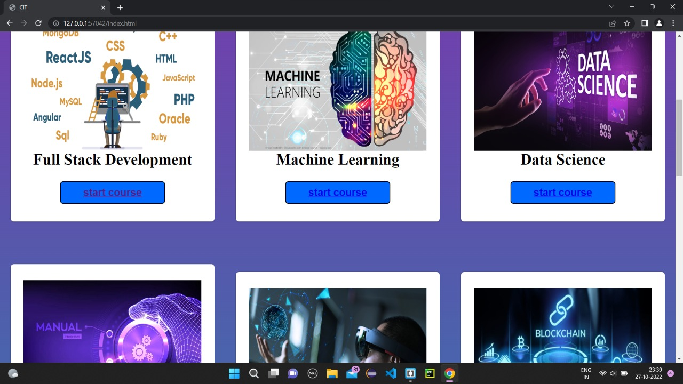

Slide 9
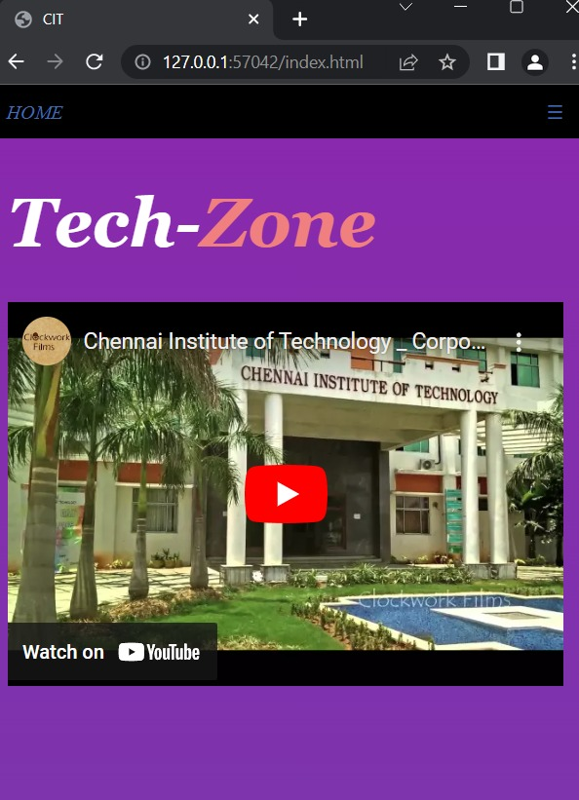

Slide 10
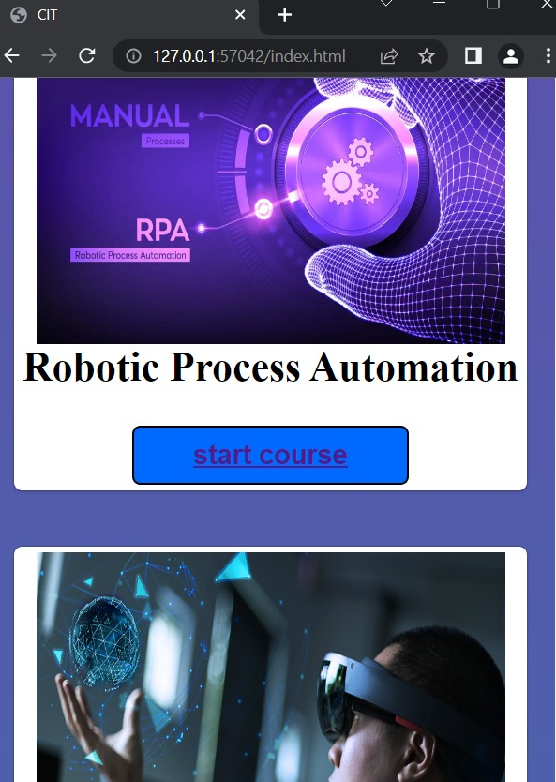

Slide 11
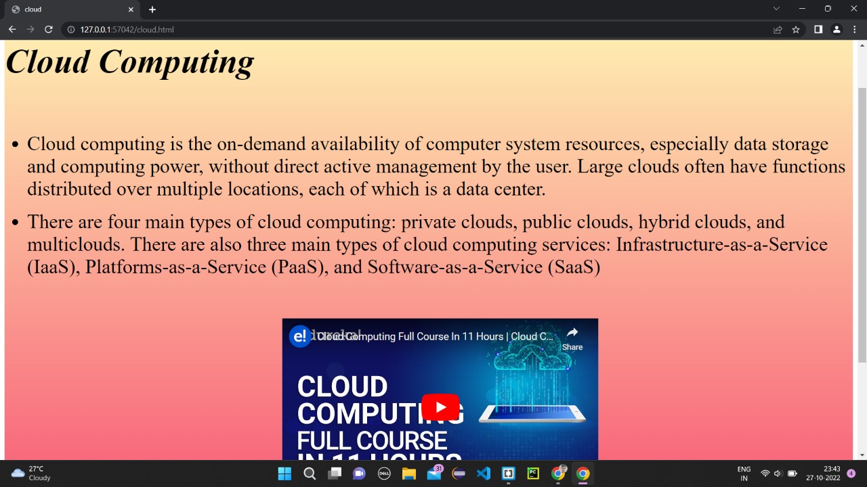

Slide 12
